Slide 1

Total Addressable Market
Serviceable Addressable Market
Serviceable Obtainable Market

Slide 2
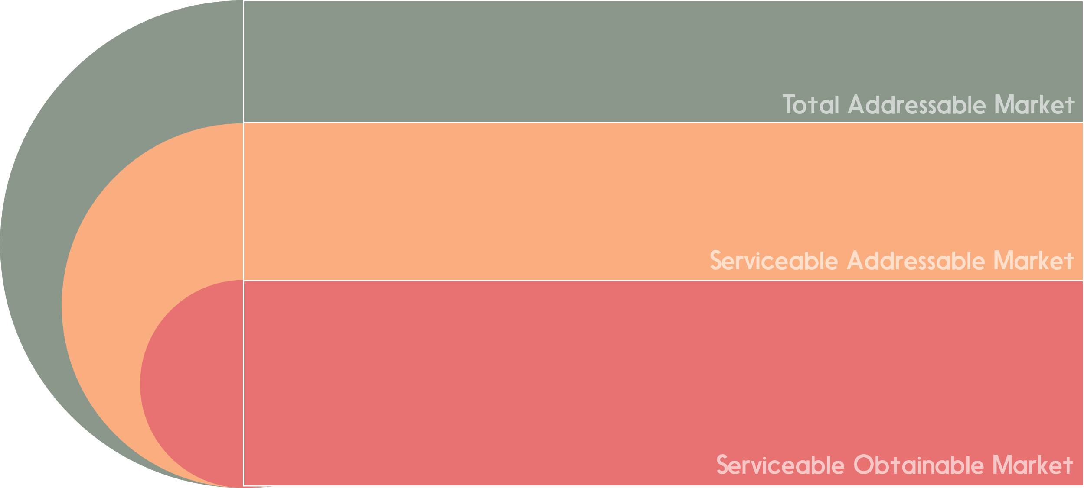
Explain TAM here
Explain SAM here
Explain SOM here

